Slide 1

Release Updates
NIEM 4.2 Update NIEM 5.0 Way Ahead

Slide 2
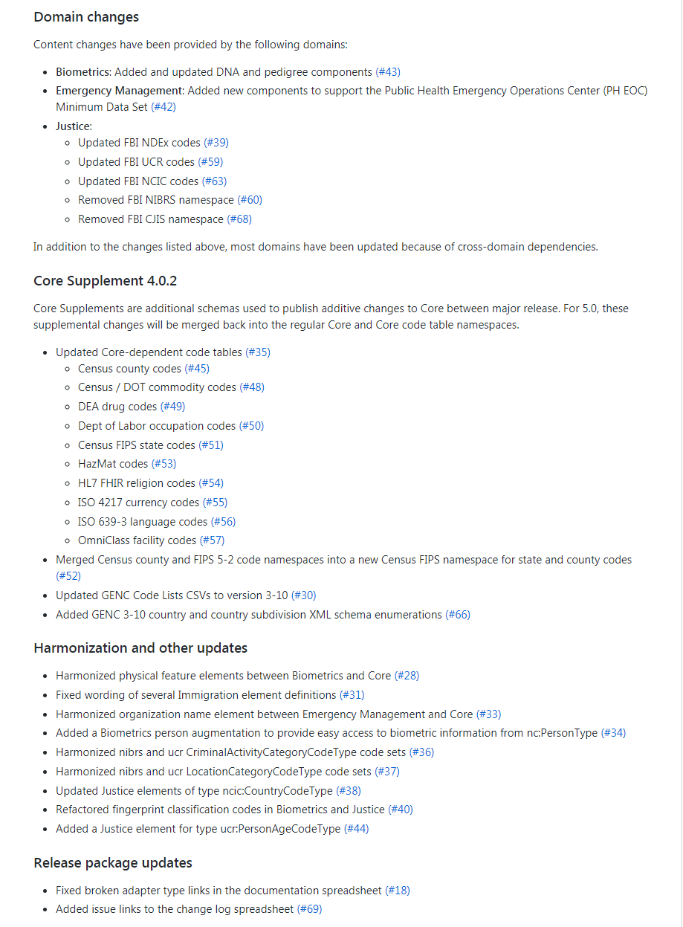
4.2 Release – Update
NIEM 4.2 to be released very soon (October)
Domains with new or updated content:
Biometrics
Emergency Management
Justice
Core Supplement 4.0.2
GENC update
Harmonization and QA fixes
Tool updates:
Movement
Schema Subset Generator Tool (SSGT)
Migration Tool
https://github.com/NIEM/NIEM-Releases
Change summary in 4.2 Readme

Slide 3
4.2 Release Stats
NIEM 4.2 | Properties | Types | Codes
Core | 1,586 | 271 | 185
Domains | 9,919 | 2,552 | 9,436
Agriculture | 64 | 8
Biometrics | 1,012 | 591 | 1,327
CBRN | 608 | 147
Emergency Management | 822 | 333 | 1,234
Human Services | 812 | 276 | 1,048
Immigration | 457 | 95 | 1,388
Infrastructure Protection | 31 | 8 | 3
Intelligence | 66 | 17
International Trade | 534 | 91
Justice | 4,206 | 502 | 217
Maritime | 339 | 47 | 180
Military Operations | 306 | 132 | 130
Screening | 599 | 255 | 3,731
Surface Transportation | 63 | 50 | 178
Code Sets | 5 | 1,098 | 73,009
Total | 11,510 | 3,921 | 82,630
 | Types | Codes
Code Sets | 1,098 | 73,009
aamva_d20 | 84 | 732
ag_codes | 62 | 79
apco | 8 | 206
atf | 8 | 98
can | 2 | 13
cbrncl | 131 | 2,435
census | 2 | 3,235
commodity | 8 | 131
dea | 6 | 482
dod_jcs-pub2.0 | 2 | 11
dol | 2 | 840
edxl_rm | 4 | 24
fips_5-2 | 2 | 69
genc | 4 | 5,623
have-codes | 24 | 43
hazmat | 2 | 2,441
hl7 | 2 | 83
iso_3166 | 8 | 5,698
iso_4217 | 2 | 182
iso_639-3 | 2 | 8,393
itcodes | 44 | 2,219
jc3iedm | 4 | 364
jp3-52 | 5 | 117
mmucc | 146 | 700
ncic | 184 | 31,982
ndex | 250 | 4,560
nga | 4 | 50
nlets | 6 | 20
occs | 6 | 1,006
sar | 8 | 76
ucr | 56 | 528
unece | 12 | 151
usda_fsa | 4 | 347
usps | 2 | 62
xCard | 2 | 9

Slide 4
5.0 Release Plans
Major release
Content changes to Core and domains
Core Supplements merged into Core
Expected new domains: Cyber and Statistics
Architectural changes
Projected schedule:
Alpha 1 March 2020
Beta 1 May 2020
RC 1 Aug 2020
Release Fall 2020
Harmonization Workgroup in progress
Review issues and provide recommendations to the NBAC
Focus is on Core issues and harmonization across Core and the domains
Workgroup also represents currently inactive domains
Track updates at http://niem.github.io/niem-releases/

Slide 5
5.0 Content Submissions
Major changes:
NIEM-conformant XML schema
make changes to the most recently published schema (4.2 release)
check NDR conformance in ConTesA - https://tools.niem.gov/contesa
Change Request spreadsheet
enables a detailed change log
Smaller changes:
Provide a detailed text description
Submit changes to:
niem-comments@lists.gatech.edu or
Issue tracker for NIEM releases repo on GitHub https://github.com/NIEM/NIEM-Releases/issues
http://niem.github.io/niem-releases/

Slide 6
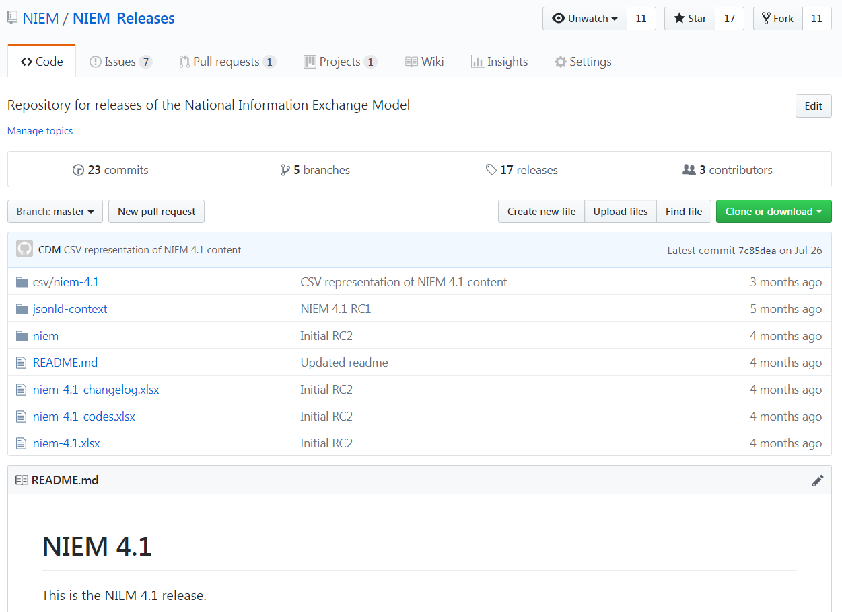
NIEM Releases – GitHub Walkthrough
https://github.com/NIEM/NIEM-Releases or search for "niem release github"

